Slide 1


A duck has 4 legs.
click here to download more https://t.me/EnglishZonePowerPoints

Slide 2
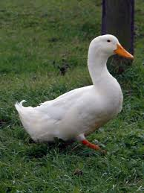
A duck has 4 legs.

Slide 3
A frog can fly.

Slide 4
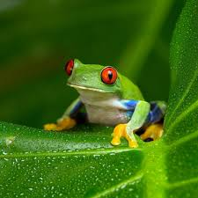
A frog can fly.

Slide 5
A fish can swim.

Slide 6
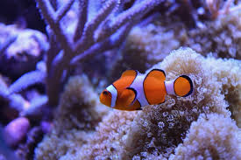
A fish can swim.

Slide 7
A cat has 6 ears.

Slide 8
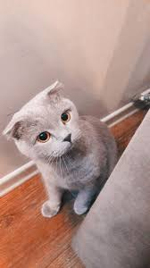
A cat has 6 ears.

Slide 9
A bird can fly.

Slide 10
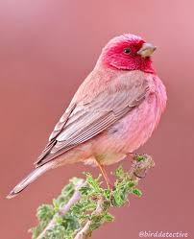
A bird can fly.

Slide 11
A giraffe is small.

Slide 12
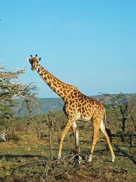
A giraffe is small.

Slide 13
A horse has 2 legs.

Slide 14
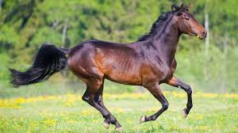
A horse has 2 legs.

Slide 15
A tiger is red and green.

Slide 16
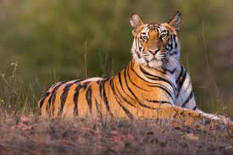
A tiger is red and green.

Slide 17
A rabbit has long ears.

Slide 18
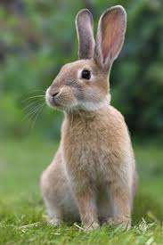
A rabbit has long ears.

Slide 19
A cow can fly.

Slide 20
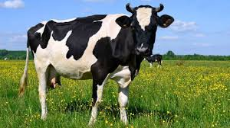
A cow can fly.

Slide 21
A spider can swim.
click here to download more https://t.me/EnglishZonePowerPoints

Slide 22
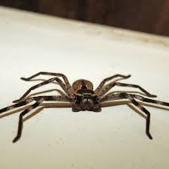
A spider can swim.

Slide 23
An elephant has 2 ears.

Slide 24
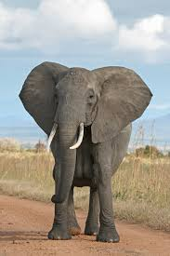
An elephant has 2 ears.

